Slide 1
SUPRT Data Collection Training

Slide 2
Learning Objectives
Understand the purpose of grant-required data collection and partnership with PRG
Learn how and when to collect grant-required data using the new SUPRT tool

Slide 3
Training
Overview
Introduction
SUPRT Materials and Instructions
Frequently Asked Questions

Slide 4
Part 1: Introduction

Slide 5
Your organization provides services that are funded by a grant from the Substance Abuse and Mental Health Services Administration (SAMHSA).

Slide 6
To monitor and improve grant performance, SAMHSA requires the programs it funds to collect and report data on the services they provide.
Learn more about performance measures on SAMHSA’s website.

Slide 7

Who are we?
The Policy & Research Group (PRG)
A private research and evaluation firm
Your organization contracted with us to create a web-based system for grant-required data collection and reporting.
Learn more on our website.

Slide 8

Grant-required data collection:
BEFORE October 1, 2025, grant-required client data were collected by grantees using the GPRA or NOMs tools.

Slide 9
NOW SAMHSA is requiring client data to be collected using the
SUPRT
SAMHSA’s
Unified
Performance
Reporting
Tool

Slide 10
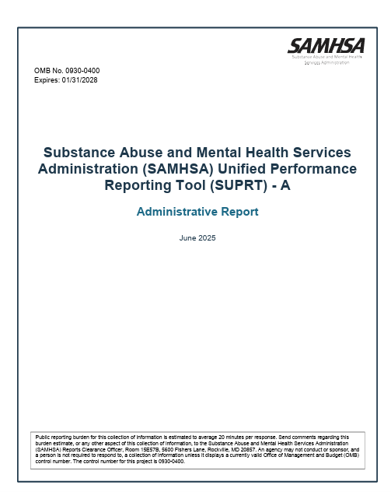
What is SUPRT?
A questionnaire that collects data from clients receiving SAMHSA-funded services
Used to standardize the data that are collected across all grant programs

Slide 11
SUPRT data will help SAMHSA provide timely, accurate information to stakeholders and Congress on the status of grant activities.

Slide 12
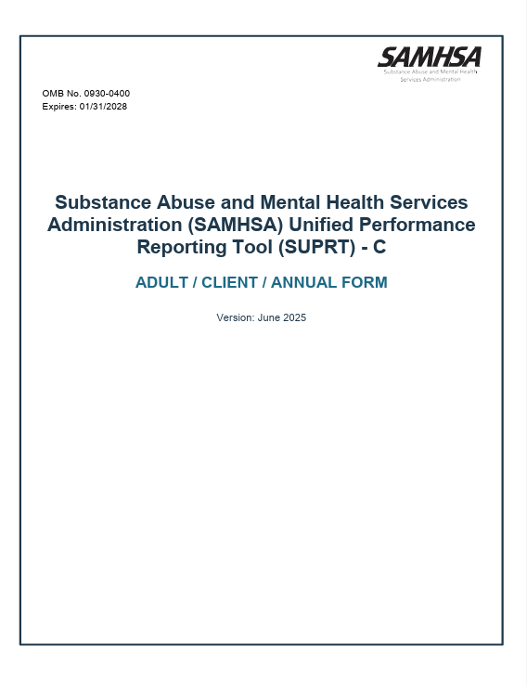
The tool has two parts:
SUPRT-A
SUPRT-C

Slide 13
The tool has two parts:
SUPRT-A
SUPRT-C
Completed by: Grantee staff (provider)
Sections: Behavioral health history, screenings, diagnoses, services received
“A” is the Administrative Report and should be completed by the provider. It covers:
Record management
Behavioral health history
Screenings
Diagnoses
Services received

Slide 14
The tool has two parts:
SUPRT-A
SUPRT-C
“C” is the Client Report and is completed by the individual enrolled in the grant-funded program(s). It covers:
Demographics
Social drivers of health
Measures of recovery
Client goals

Slide 15

When does SUPRT need to be completed?
Data collection timepoints
Window open and close details

Slide 16
FOR ALL CLIENTS, no matter how long in the program:
Program Intake
Program
Exit
Provider and new client complete Baseline Assessment SUPRT-A+C
Provider completes Record Closeout SUPRT-A only

Slide 17
Depending on the length of the client’s episode of care:
Program Intake
Program
Exit
6 months later
One year later*
Provider and new client complete Baseline Assessment SUPRT-A+C
If still enrolled, complete 6-month Reassessment SUPRT-A+C
If still enrolled, complete Annual Assessment SUPRT-A+C
Provider completes Record Closeout SUPRT-A only

Slide 18
Let’s take a closer look at the data collection details for each time point…

Slide 19
Client Intake
30-day data collection window
Use the Client ID List to assign client ID then complete baseline SUPRT assessment (parts A and C) with client within 30 days after they first receive grant-funded services.

Slide 20
6 Months Later
60-day data collection window
If the client is still receiving services, complete the 6-month Reassessment (SUPRT A+C) up to 30 days before and after the 6-month mark.

Slide 21
*
One Year Later
60-day data collection window
If the client is still receiving services at this timepoint, complete the Annual Assessment (SUPRT A+C) up to one month before and after the 12-month mark.
*Going forward, complete an Annual SUPRT
Assessment each year the client is still enrolled.

Slide 22
Program Exit
30-day data collection window
Complete SUPRT-A (Record Closeout) for client within 30 days of program exit/discharge.

Slide 23
Note:
  If 6-month or annual assessments are not completed during the data collection window, assessment records for those timepoints are not required by SAMHSA. Instead, providers should complete the next assessment due.
  For example, if the 6-month window is missed and the client is still in care at 12 months, complete an Annual Assessment when that window opens.

Slide 24
Part 2: SUPRT Materials and Instructions

Slide 25
Provider Registration Form
Client ID List
Data collection materials
SUPRT Online Form
Client Tracking Dashboard
  PRG emails providers the Client ID List file; links to all data collection materials are saved in the ‘User Guide & Resources’ tab of the Client Tracking Dashboard.
SUPRT Resources

Slide 26

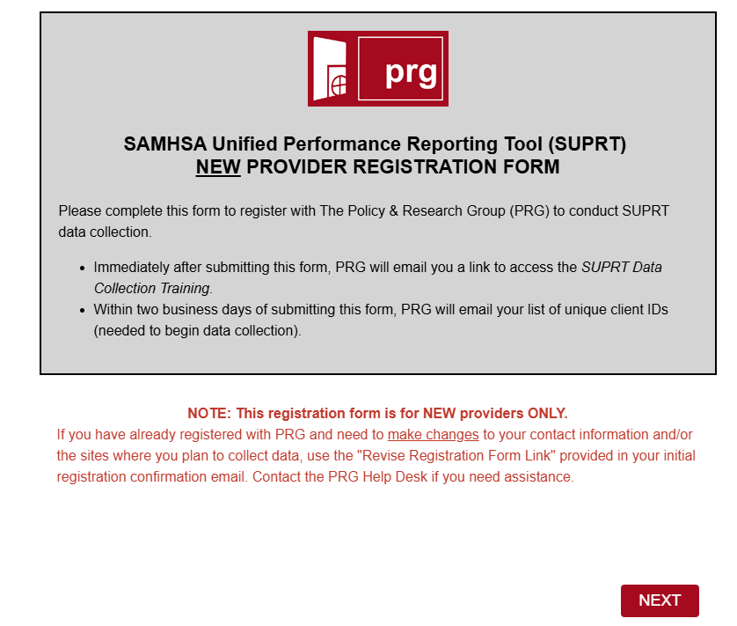
Provider Registration Form
  PRG or your grant contact will provide a link to the New Provider Registration Form.
  New providers will need to fill out the form in order to access SUPRT data collection materials and the SUPRT Online Form.
  If you previously completed GPRA or NOMs data collection training with PRG and already have your Client ID List, do not fill out this form.
  NEW PROVIDERS - Fill out the form as soon as you get the link to ensure access to the SUPRT Online Form!

Slide 27
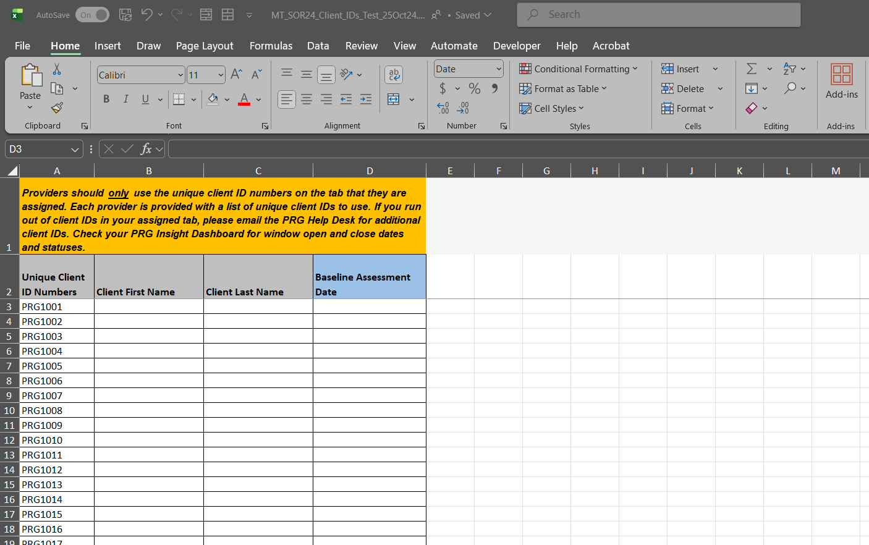
Provider Registration Form
Client ID List
  PRG will give each provider an Excel sheet that includes a set of unique ID numbers.
  The provider assigns an ID to each client at their baseline assessment and uses the same ID on all subsequent assessments.
  This ensures the client’s name is never submitted to PRG or SAMHSA.
  We recommend you save this to a secure, easily accessible location on your computer to access throughout the grant!

Slide 28
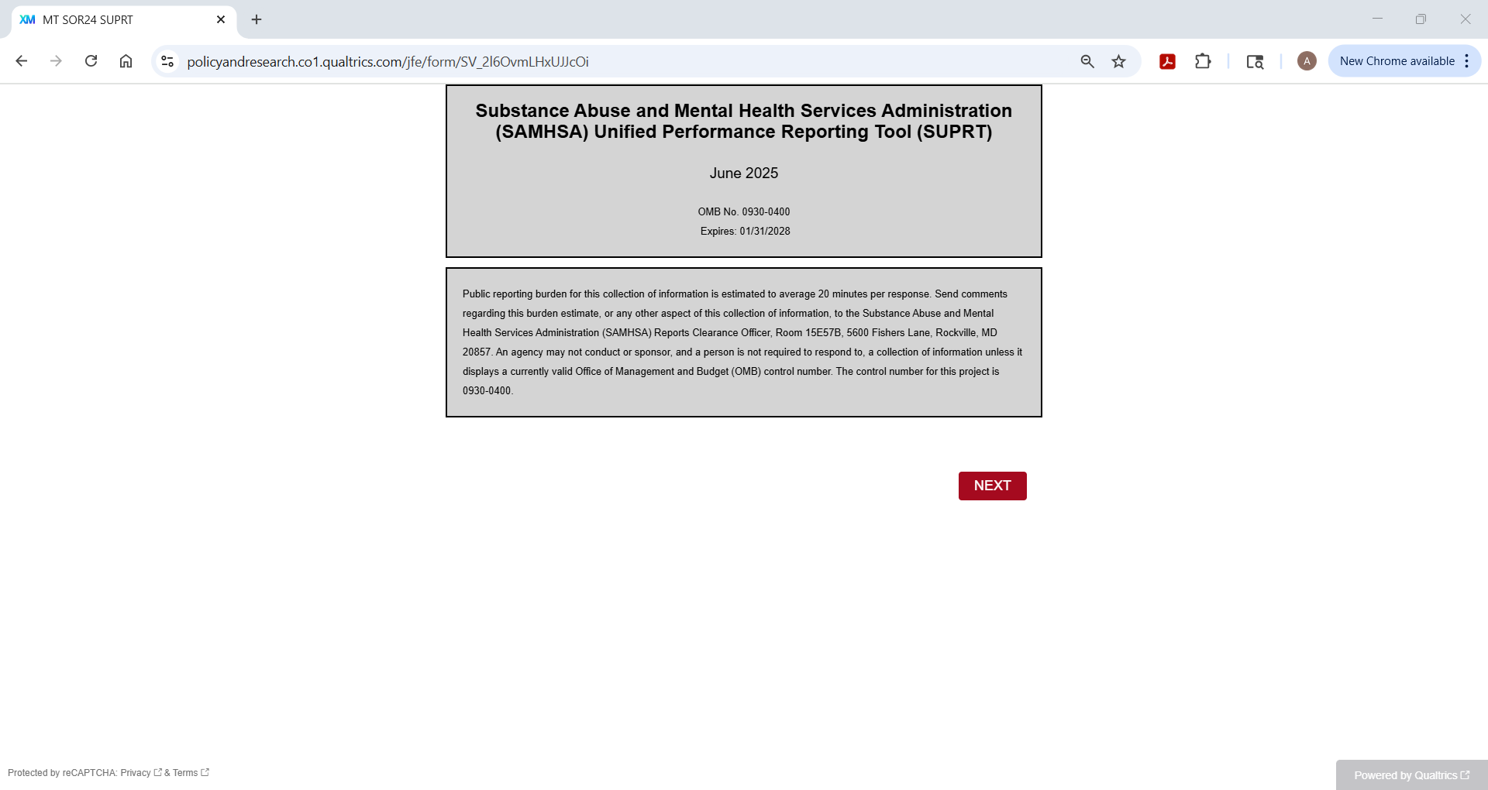
Provider Registration Form
  Bookmark the SUPRT Online Form link in your browser for easy access each time you need it!
Client ID List
SUPRT Online Form
  PRG will give each provider a link to the SUPRT Online Form.
  Providers will also have access to SUPRT PDFs that can be printed if necessary to accommodate client needs.
How to create bookmarks in Chrome.

Slide 29
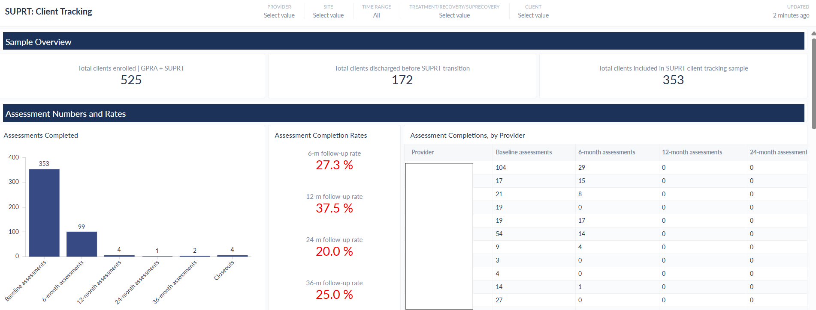
Provider Registration Form
  Add another bookmark for the Client Tracking Dashboard!
Client ID List
SUPRT Online Form
Client Tracking Dashboard
  PRG will give providers access to the Client Tracking Dashboard – a tool to monitor which clients are due for assessments

Slide 30
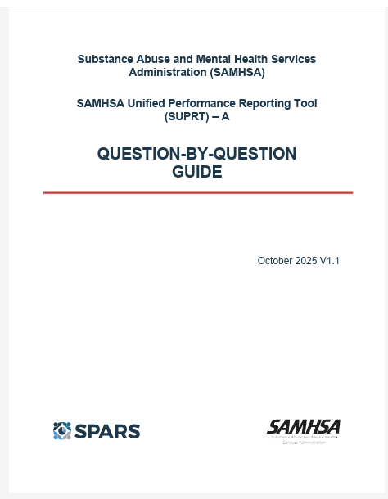
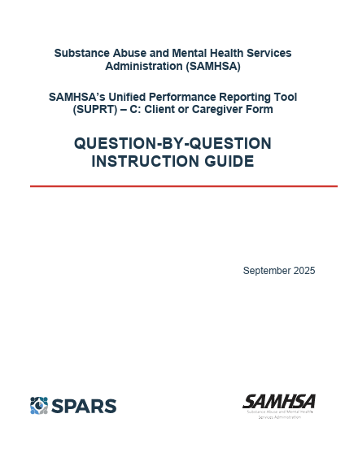
Provider Registration Form
Client ID List
SUPRT Online Form
Client Tracking Dashboard
SUPRT Resources
  Guides are available to help you complete the SUPRT.
  Links to these resources are included in the ‘User Guide & Resources’ tab of the dashboard.

Slide 31
In order to use the SUPRT data collection and client tracking systems, you will need to register with PRG as a provider.
Open the link to the New Provider Registration Form provided by your grant contact or PRG.
Fill out the form with your contact and site information and click SUBMIT when finished.
You must use the same email address provided in the form to access the SUPRT Online Form and receive notifications.
You will receive an email within 2 business days with your client ID list and the link to the SUPRT Online Form.
How to register as a SUPRT provider
Provider Registration Form
If you previously completed GPRA training with PRG and already have your Client ID List, DO NOT fill out this form.

Slide 32
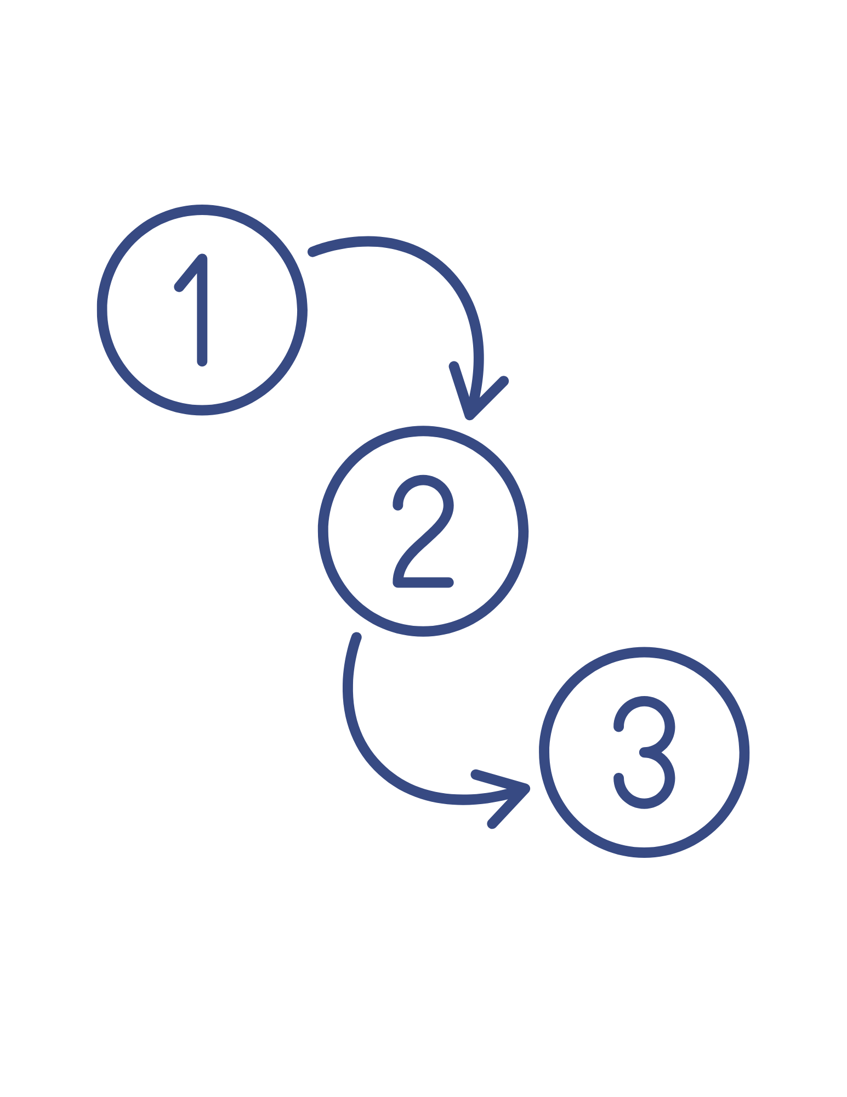
SUPRT Instructions for Providers
Assign or look up client ID number
Access SUPRT Online Form and answer Record Management questions
Obtain consent and have client complete SUPRT-C (if required at that time point)
Complete SUPRT-A
Use client tracking dashboard and email notification systems to track assessments due

Slide 33
Let’s go through the instructions step-by-step…

Slide 34
At baseline…
Open your Client ID List provided by PRG
Identify the next available ID number
Assign the ID by entering the client’s first and last name along with the date of their baseline SUPRT assessment
At reassessment (6-month, annual, record closeout)…
Look up the client’s ID number on your Client ID List using their first and last name (you will need it to start the SUPRT form)
Assign or look up
client ID number
Client ID List

Slide 35

Client ID List Video Tutorial
Watch this 1-minute video to see how to use the Client ID List:
  Watch on YouTube for closed captions

Slide 36
Access the SUPRT Online Form using the link provided by PRG
Carefully enter your email address and the client’s ID number from the Client ID List
Answer all Record Management questions
If SUPRT-C is required at the time point selected, you will continue to the client consent information section
Open and complete SUPRT Online Form
SUPRT Online Form

Slide 37

Watch this 2-minute video to see how to complete the SUPRT Record Management Section:
  Watch on YouTube for closed captions

Slide 38
Review the consent information with the client
Obtain client consent
SUPRT Online Form

Slide 39
Consent guidelines (included in online form):
Clients may indicate at any point that they do not wish to complete the assessment.
Participation, although encouraged, is completely voluntary.
Declining does not affect a client’s eligibility for any grant-funded services and does not negatively affect grantee compliance.
Clients can leave any question they do not want to answer blank.

Slide 40
Review the consent information with the client
Answer the question indicating if the client agrees to complete the SUPRT-C (if “no”, indicate why; if “yes”, enter the client assessment date)
Obtain client consent
SUPRT Online Form

Slide 41
If the client agrees to complete the SUPRT-C, determine how they will complete it
Client completes SUPRT-C
SUPRT Online Form

Slide 42






Options for completing SUPRT-C:
  Client fills out the SUPRT-C directly on provider’s computer or device
  Client completes SUPRT-C interview-style (the provider reads the questions and response options aloud, filling out the online form as they go)
  Client completes paper version of SUPRT, provider enters data into the online form

Slide 43
If the client agrees to complete the SUPRT-C, determine how they will complete
The client responds to the SUPRT-C questions
Client completes SUPRT-C
SUPRT Online Form

Slide 44
Answer SUPRT-A questions using client records
Click the “submit” button at the end of the online form to complete
Check your inbox for a confirmation email confirming the online form was submitted (email also includes responses submitted in the form) – if you don’t see the email in your inbox, check your spam folder
Complete SUPRT-A
SUPRT Online Form

Slide 45

Watch to learn more about SUPRT confirmation emails
(1 min):
  Watch on YouTube for closed captions

Slide 46
SUPRT-A Reminders:
Must be completed at each assessment timepoint that the client is still in care, even if the client refuses to complete SUPRT-C
Behavioral health data can be entered by any grantee staff (they do not need to be a licensed clinician)
To fill out SUPRT-A, pull information from data recorded in your organization’s record keeping system(s)
If the information is not available in your organization’s record keeping system(s), you should select the response option: “Not documented in records or not documented in records using this standard.”

Slide 47

SUPRT-C Video Tutorial
The online form makes using SUPRT easy! It alerts you of potential errors and uses logic to hide irrelevant questions. Watch the 2-min video:
  Watch on YouTube for closed captions

Slide 48

Once you have filled out the SUPRT Online Form, you must click “submit” for responses to be recorded.
SUBMIT
You will receive a confirmation email from PRG to let you know that the form was submitted.
If you do not get a confirmation email, the form was not submitted or received by PRG.

Slide 49
The SUPRT can be completed offline but responses still must be submitted online.
If for some reason you do not have internet access, you and the client can complete the SUPRT using a PDF provided by PRG (PDF must be printed).
Providers are responsible for making sure responses from paper/PDF SUPRTs are then entered and submitted in the online form.

Slide 50
To keep track of when clients are due for reassessment, open the Client Tracking Dashboard using the link provided by PRG.
Go to the Client Tracking tab.
Use the tab filters to view detailed client information for a specific client ID, site, provider, and/or time range.
Reach out to clients who are still receiving services with open data collection windows to schedule a time to complete SUPRT-C.
Track assessments due
Client Tracking Dashboard

Slide 51

Client Tracking Dashboard Video Tutorial
Watch to learn more about using the Client Tracking Dashboard
(1 min):
  Watch on YouTube for closed captions

Slide 52
Remember that a reassessment SUPRT is only required for clients still enrolled (receiving grant-funded program services) at the time the window opens.

Slide 53
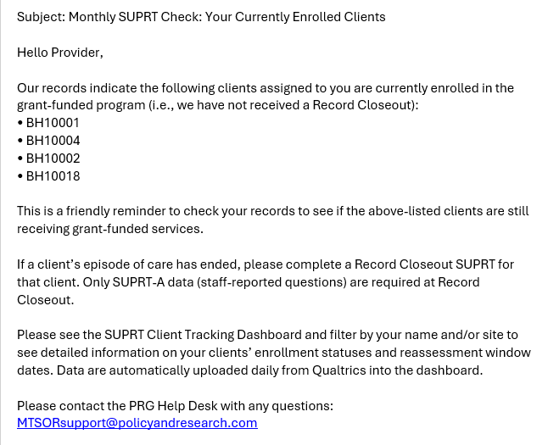
PRG helps providers keep client data up to date by sending monthly emails that:
List clients still enrolled in the program
Prompt providers to check each client’s status and complete record closeouts, if needed

Slide 54
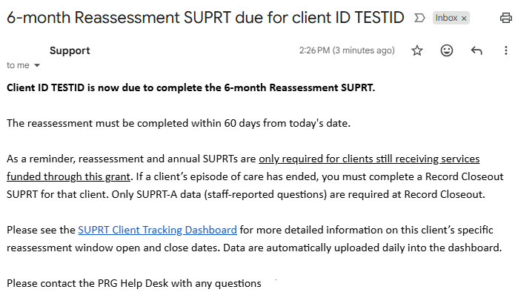
PRG helps providers keep client data up to date by sending reassessment reminder emails on the day windows open that:
Lists client ID now due to complete reassessment
Includes reminder that reassessments are only required for clients still in care
Prompts providers to check Client Tracking Dashboard for more detailed information on client’s specific window open and close dates

Slide 55
Part 4: Frequently Asked Questions

Slide 56
Frequently Asked Questions
Click the question to see the answer.
What is SUPRT?
How do I know when a SUPRT is due?
Are there expected completion rates for the SUPRT?
What if my client’s reassessment window closed before I was able to complete a SUPRT?
Do clients receive incentives for completing SUPRT?
When does SUPRT need to be completed?
How do clients complete SUPRT?
Who is PRG?
What if my client was enrolled using the GPRA?
What if a client was discharged and re-enrolls in services?

Slide 57


How do I know when a SUPRT is due?
You will receive reassessment reminder emails for currently enrolled clients the day their data collection window opens.
Providers should also access the Client Tracking Dashboard online to monitor when reassessment windows open and close for their enrolled clients. Keep this link bookmarked for easy access throughout the grant!

Slide 58
Are there expected completion rates for SUPRT?
Previously, SAMHSA required an 80% completion rate for follow-up GPRAs but expectations for the SUPRT are different.
For SUPRT, grantees are expected to complete the BASELINE and RECORD CLOSEOUT for 100% of clients receiving services under the grant.
SAMHSA has not set required completion rates for 6-month and annual assessments; however, staff should attempt to submit the SUPRT within the 60-day window for 100% of clients still receiving services at that timepoint.

Slide 59
What if my client’s reassessment window closed before I was able to complete a SUPRT?
If you were unable to complete a reassessment during the 60-day window that’s OK.
No assessment records for those timepoints are required. Instead, providers should complete the next assessment due.
For example, if the 6-month window is missed and the client is still in care at 12 months, complete an Annual Assessment when that window opens.

Slide 60
What if my client was enrolled using the GPRA?
If the client is still receiving services, check the Client Tracking Dashboard to see when the client is due for their next assessment (e.g., 6-month, annual).
Clients who completed the GPRA tool at intake do not need to complete the client-reported SUPRT-C sections at any reassessment timepoint. Only staff-reported SUPRT-A data are collected for GPRA clients at reassessment.
When the client is ready to be discharged, complete a Record Closeout in the SUPRT Online Form.

Slide 61
Do clients receive incentives for completing the SUPRT?
Clients who complete the SUPRT-C at 6-month reassessment or annual assessment are eligible to receive 1 gift card or voucher per completed assessment, with a maximum cash value of $30/completed assessment.
Talk to your grant contact or supervisor if you have any questions about your site’s incentive policy.

Slide 62
What if a client was previously discharged and re-enrolls in services?
A new set of SUPRT assessments are required (baseline, record closeout, and reassessment/annual assessment if the client is still in care at those timepoints) for this client’s new episode of care, using the same client ID that was used on the original assessments.
Email the PRG Help Desk to let PRG know that the client is re-enrolling in services. PRG will contact you within 2 business days to let you know when you can enter a new baseline SUPRT for this client into the online SUPRT form.

