Slide 1

SUPRT Data Collection Training

Slide 2

Training Objectives
Understand the purpose of grant-required data collection and partnership with PRG
Learn how and when to collect grant-required data using the PRG Insight data dashboard and SUPRT Online Form

Slide 3

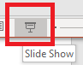
Training Logistics
For the best experience, view this PowerPoint as a slide show.
  Instructions: Click the slide show icon on the bottom right of the screen, then click through and read each slide.
Watch the videos included on some slides to see how the online data collection tools work in practice.
Ask yourself the Training Checkpoint questions to reinforce your understanding.
Use this training and the User Guide & Resources tab of the PRG Insight dashboard as a reference for any questions related to the SUPRT and client-level data collection.
?
Question
A
Answer

Slide 4



Training provider
This training is provided by The Policy & Research Group (PRG), a private research and evaluation firm
PRG developed PRG Insight, the web-based system for grant-required data collection and reporting described in this training
Learn more on our website.

Slide 5
Disclaimer
Disclaimer: PRG is not affiliated with nor do we represent SAMHSA. Please consult your SAMHSA project officer and the official SUPRT guidance as the authority.
Notes:
Important Disclaimer: PRG is not affiliated with nor do we represent SAMHSA. Please consult your SAMHSA project officer and the official guidance as the authority.

Slide 6
Training
Overview
Introduction
Data Collection Schedule
SUPRT Materials
SUPRT Instructions
Frequently Asked Questions

Slide 7
Part 1: Introduction

Slide 8
Background
Your organization provides services that are funded by a grant from the Substance Abuse and Mental Health Services Administration (SAMHSA).

Slide 9
Background, continued
To monitor and improve grant performance, SAMHSA requires the programs it funds to collect and report data on the services they provide.
Learn more about performance measures on SAMHSA’s website.

Slide 10
Grant-required data collection
Before October 1, 2025, grant-required client data were collected by grantees using the GPRA.

Slide 11
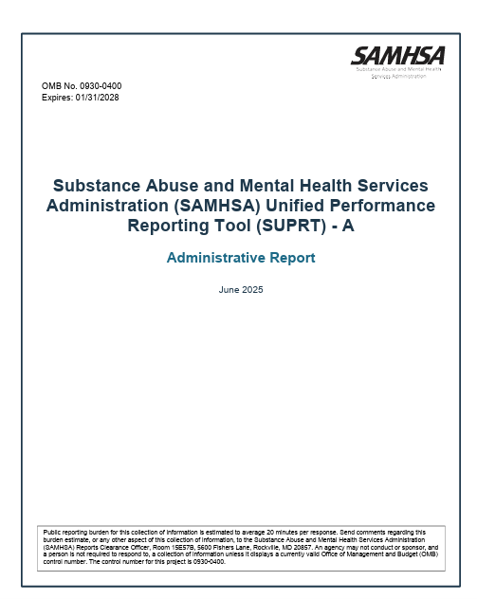
Grant-required data collection, continued
Now, SAMHSA is requiring client data to be collected using SUPRT –
SAMHSA’s
Unified
Performance
Reporting
Tool

Slide 12

What is SUPRT?
A questionnaire that collects data from clients receiving SAMHSA-funded services
It is used to standardize the data that are collected across all of SAMHSA’s grant programs
The tool has two parts: SUPRT-A and SUPRT-C

Slide 13
SUPRT Purpose
SUPRT data helps SAMHSA provide timely, accurate information to stakeholders and Congress on the status of grant activities.

Slide 14
Intro to PRG Insight
To ease the burden of SUPRT data collection and reporting to SAMHSA, PRG created a web-based system, called PRG Insight.

Slide 15
What is PRG Insight?
A web-based system for grant-required data collection and reporting
It includes several components:
  SUPRT Online Form
  SUPRT Data Dashboard
  User Guide & Resources tab with data collection training materials
  Data reporting to SAMHSA
PRG Insight automates uploads of SUPRT data to SPARS (SAMHSA’s Performance Accountability Reporting System), so you stay in compliance with SAMHSA’s data requirements

Slide 16
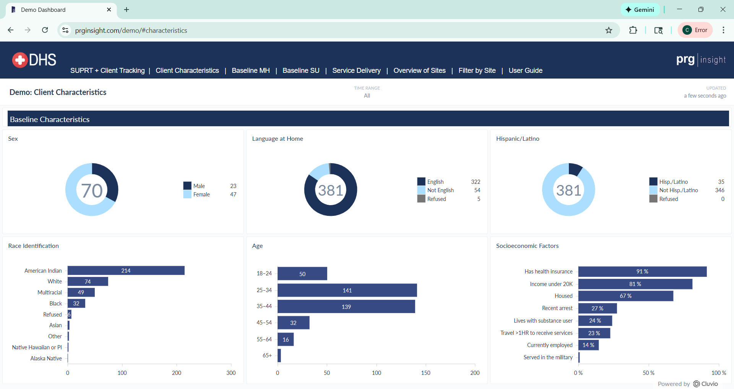
What is the PRG Insight Data Dashboard?
To give organizations access to the SUPRT data they collect, PRG created the PRG Insight data dashboard. It will include 5 tabs that will be updated daily:
Client Tracking
Client Characteristics
Implementation Evaluation
Outcome Evaluation
Service Delivery
Client Demographics tab of the PRG Insight data dashboard
Notes:
Note that only Client Tracking tab is currently available – the other tabs will be developed and added to the dashboard later.

Slide 17
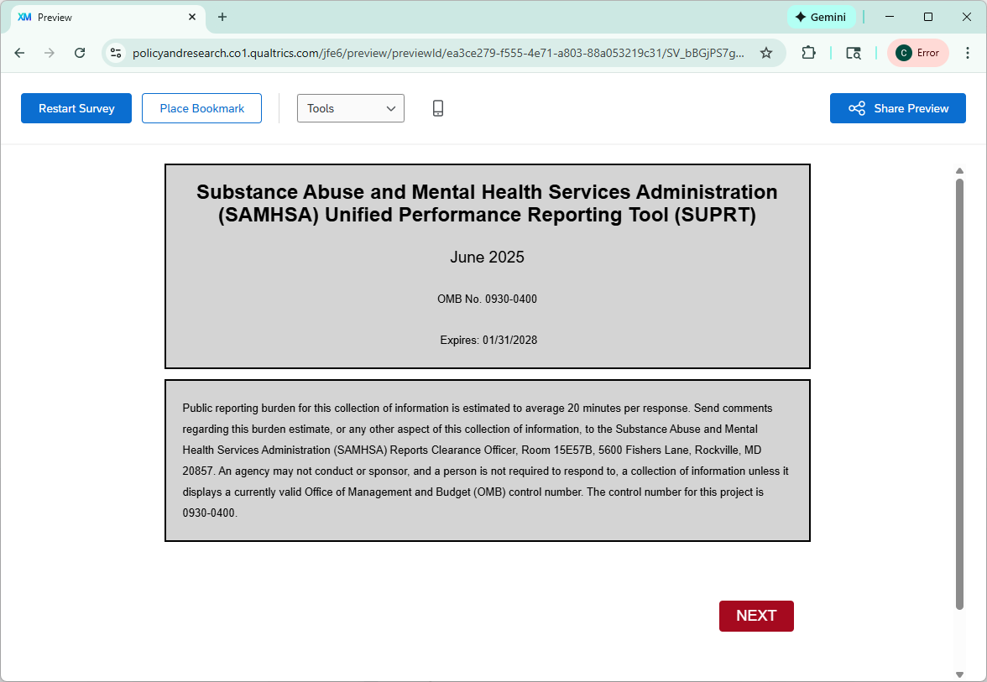
SUPRT Details
Keep in mind that the online form will direct you to the applicable questions for the timepoint; it skips questions that are not applicable
SUPRT Online Form

Slide 18
SUPRT-A Intro
The tool has two parts:
SUPRT-A
SUPRT-C
“A” is the Administrative Report and should be completed by the case manager. It covers:
Record management
Behavioral health history
Screenings
Diagnoses
Services received
SUPRT Online Form

Slide 19
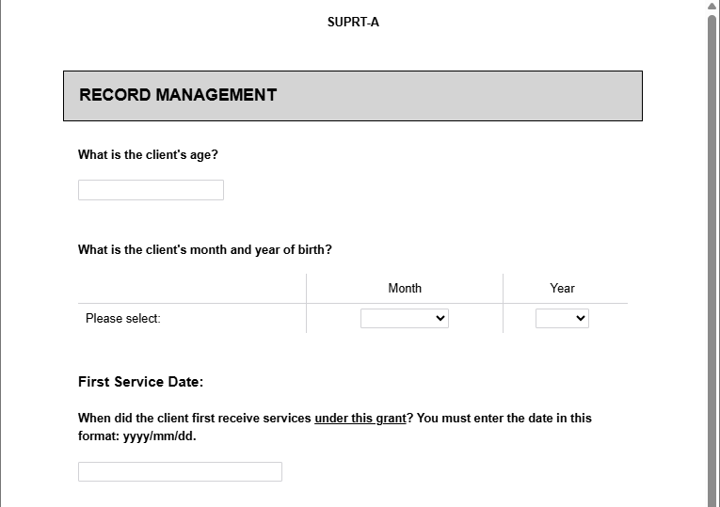
SUPRT-A Record Management
SUPRT-A
SUPRT-C
RECORD MANAGEMENT
Collected at 4 timepoints:
  Baseline
  Reassessment
  Annual assessment
  Closeout
Collects information on:
  Client and grantee identification
  Assessment information
Section A of the SUPRT Online Form
Notes:
Section A covers record management, and it’s completed at four time points: baseline, reassessment, annual assessment, and closeout. We’ve included screenshots of the first pages of each section on the right of the slide, but we know the text is pretty small, so don’t worry if you can’t read it. It’s just there to give you an idea of what the section looks like.
The SUPRT A record management section includes client and grantee identification information and the required assessment details. As you are used to from the GPRA, there are skip patterns in this instrument. For example, this section collects information on client’s date of birth. That question is only to be answered at baseline, but skipped otherwise.

Slide 20
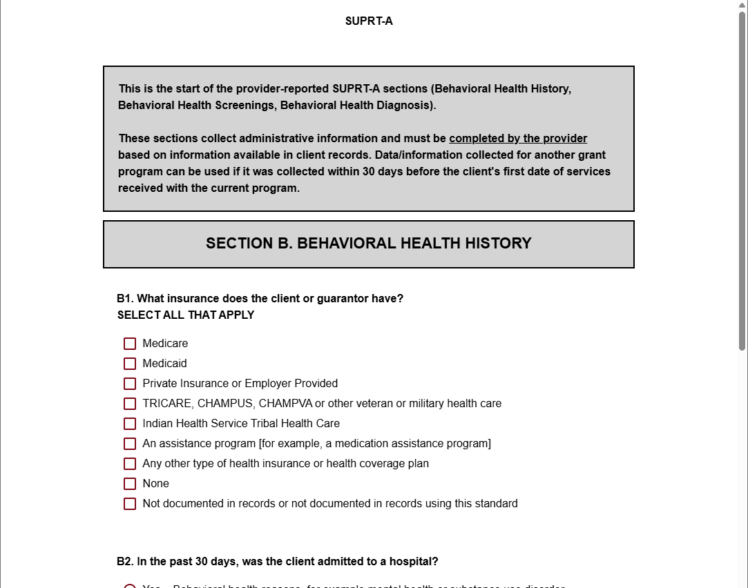
SUPRT A – Behavioral Health History
SUPRT-A
SUPRT-C
B. BEHAVIORAL HEALTH HISTORY
Collected at 3 timepoints:
  Baseline
  Reassessment
  Annual assessment
Collects information on:
  Insurance
  Use of hospitals or emergency services
  Involvement with justice system
Section B of the SUPRT Online Form
Notes:
Section B, behavioral health history is completed at 3 time points: baseline, reassessment, and annual assessment. This section collects information on the client’s insurance, use of hospitals or emergency services, and their involvement with the justice system. These data are used to monitor program outcomes such as increasing access to care and decreased use of emergency systems or justice system involvement.

Slide 21
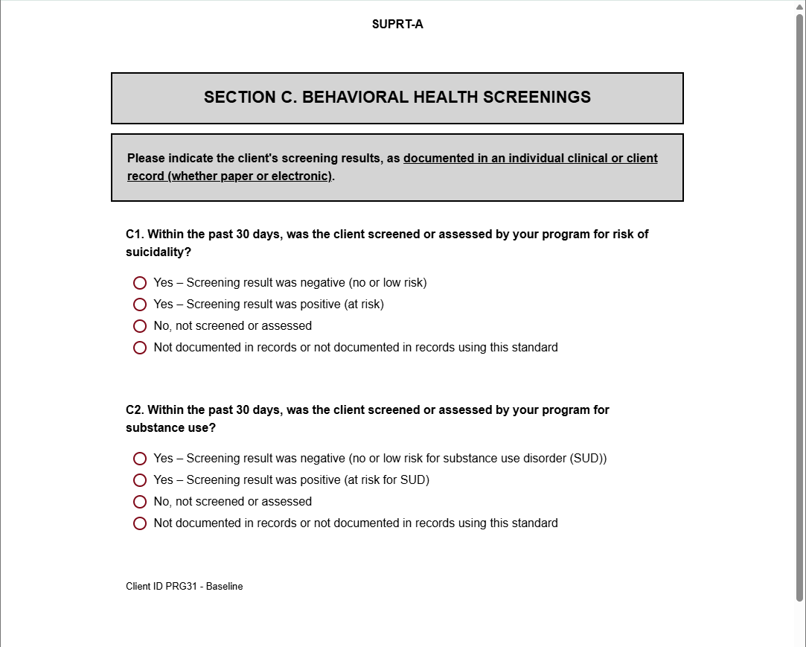
SUPRT-A Behavioral Health Screenings
SUPRT-A
SUPRT-C
C. BEHAVIORAL HEALTH SCREENINGS
Collected at 3 timepoints:
  Baseline
  Reassessment
  Annual assessment
Collects information on:
  Behavioral health screenings: suicidality, substance use, mental health disorders
Section C of the SUPRT Online Form
Notes:
Section C, Behavioral health screenings, is collected at baseline, reassessment, and annual assessment. This section collects behavioral health information, including screenings for suicidality, substance use, and mental health disorders. These data are used to track client behavioral health outcomes.

Slide 22
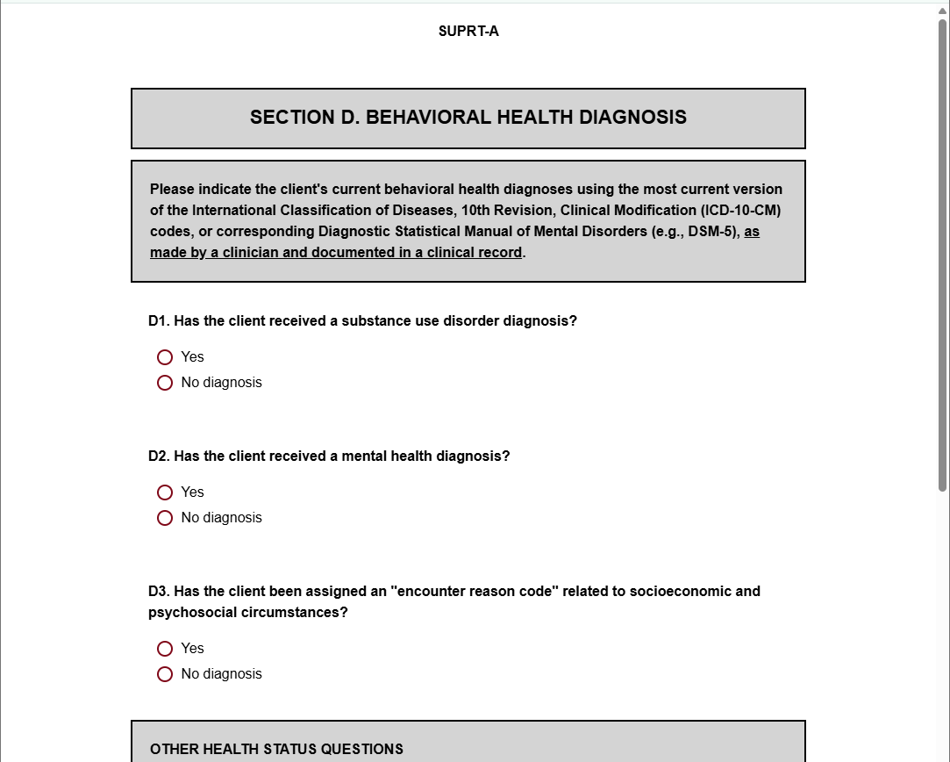
SUPRT-A Behavioral Health Diagnosis
SUPRT-A
SUPRT-C
D. BEHAVIORAL HEALTH DIAGNOSIS
Collected at 3 timepoints:
  Baseline
  Reassessment
  Annual assessment
Collects information on:
  Behavioral health diagnoses
  Health statuses
Section D of the SUPRT Online Form
Notes:
Section D. Behavioral Health Diagnoses is collected at baseline, reassessment, and annual assessment
It collects information on diagnoses, including substance use, mental health, and other physical health diagnoses.

Slide 23
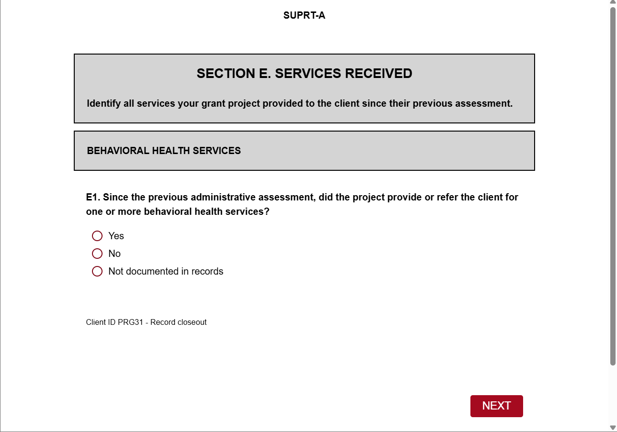
SUPRT-A Services Received
SUPRT-A
SUPRT-C
E. SERVICES RECEIVED
Collected at 3 timepoints:
  Reassessment
  Annual assessment
  Closeout
Collects information on:
  Behavioral health services
  Medication
  Crisis services
  Recovery services
  Integrated services
Section E of the SUPRT Online Form
Notes:
Section E is services received. You skip this at baseline, but you need to complete it at reassessment, annual assessment, and close out
This section collects information on the services client received since their last assessment and are used to track what services have been used. Most of the questions in Section E follow the same format that you see here on the right-hand side – a matrix of services and response options.

Slide 24
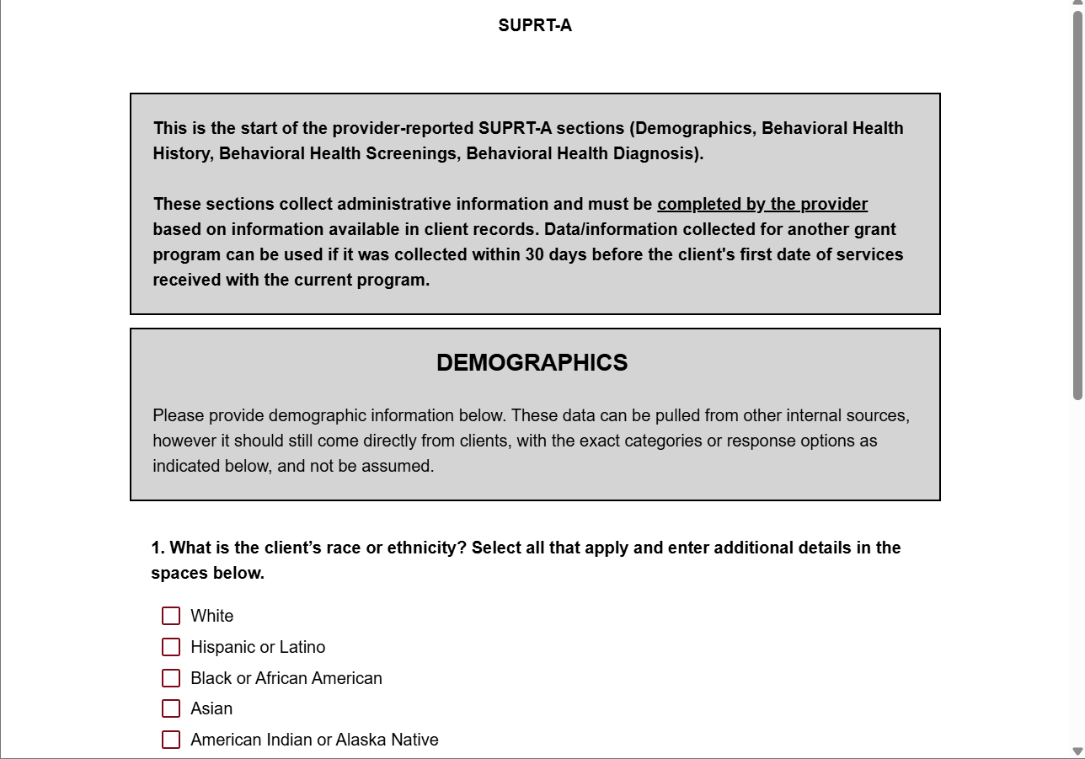
SUPRT-A Demographics
SUPRT-A
SUPRT-C
DEMOGRAPHICS
Collected at baseline ONLY if the client does not consent to complete SUPRT-C
Collects information on:
  Race/ethnicity
  Sex
Demographics section of the SUPRT Online Form
Notes:
And the final section of SUPRT-A is demographics.
The guidance here is a little tricky – you only collect demographic information in SUPRT-A at baseline if the client or caregiver did not answer any question for SUPRT-C. In other words, you only complete this section if your client did not consent to complete SUPRT-C, which is the client form.

Slide 25
Learning Checkpoint 1:
?
Who completes SUPRT-A, grantee staff or the client?

Slide 26
Answer to Learning Checkpoint 1:
A
Grantee staff (case managers) complete SUPRT-A.

Slide 27
SUPRT-C Intro
The tool has two parts:
SUPRT-A
SUPRT-C
“C” is the Client Report and is completed by the individual enrolled in the grant-funded program(s). It covers:
Demographics
Social drivers of health
Measures of recovery
Client goals
SUPRT Online Form

Slide 28
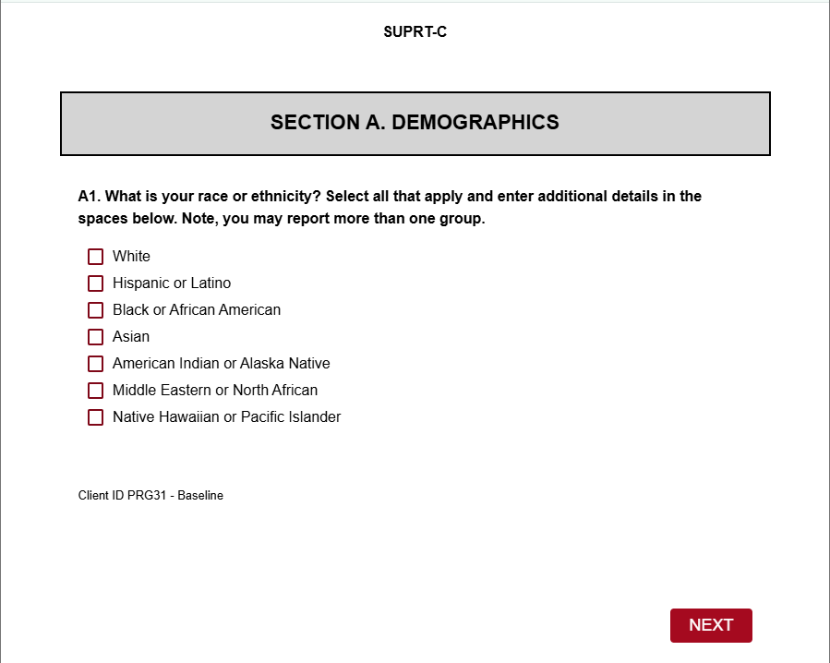
SUPRT-C Demographics
SUPRT-A
SUPRT-C
A. DEMOGRAPHICS
Collected at 1 timepoint
  Baseline
Collects information on
  Race/ethnicity
  Sex
Demographics section of the SUPRT Online Form

Slide 29
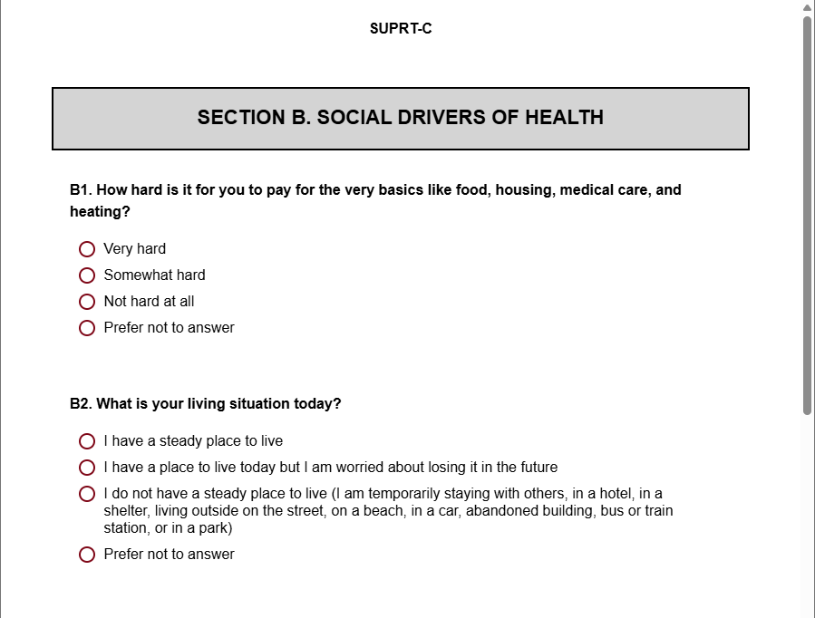
SUPRT-C Social Drivers of Health
SUPRT-A
SUPRT-C
B. SOCIAL DRIVERS OF HEALTH
Collected at 2 timepoints:
  Baseline
  Reassessment
Collects information on:
  Basic needs
  Living situation
  Employment
  Education
  Transportation
Social Drivers of Health section of the SUPRT Online Form

Slide 30
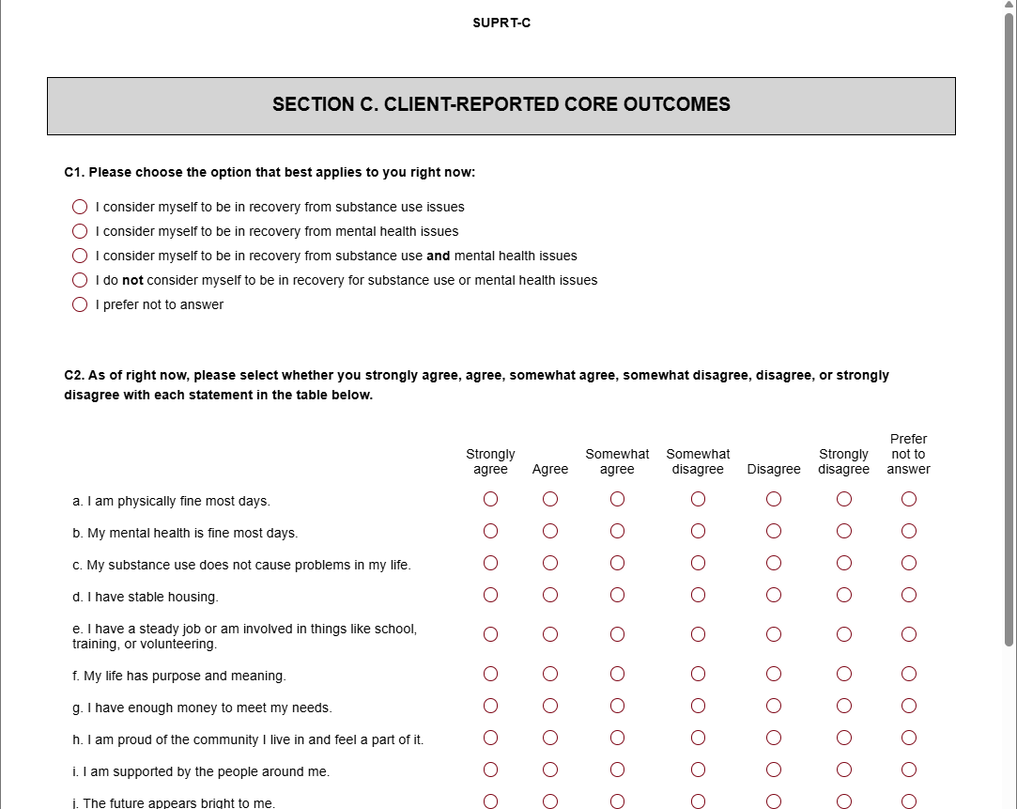
SUPRT-C Client Reported Core Outcomes
SUPRT-A
SUPRT-C
C. CLIENT-REPORTED CORE OUTCOMES
Collected at 3 timepoints
  Baseline
  Reassessment
  Annual assessment
Collects information on:
  Recovery status
  Core outcomes of recovery
  Quality of life
  Client goals
Client-Reported Core Outcomes section of the SUPRT Online Form

Slide 31
Learning Checkpoint 2:
?
Which SUPRT-C section is collected only at baseline?

Slide 32
Answer to Learning Checkpoint 2:
A
The Demographics section (of SUPRT-C) is only completed at baseline.

Slide 33
Part 2: Data Collection Scheule

Slide 34

When does SUPRT need to be completed?
The SUPRT should be completed at the timepoints described in the next 9 slides.
Each data collection timepoint includes a data collection window of 30 days (baseline and record closeout) or 60 days (reassessments).

Slide 35
SUPRT Data Collection Schedule
For all clients, no matter how long in the program:
Program Intake
Program
Exit
Case manager and new client complete Baseline Assessment SUPRT-A+C
Case manager completes Record Closeout SUPRT-A only

Slide 36
SUPRT Data Collection Schedule, continued
Depending on the length of the client’s episode of care:
Program Intake
Program
Exit
6 months later
One year later*
Case manager and new client complete Baseline Assessment SUPRT-A+C
If still enrolled, complete 6-month Reassessment SUPRT A+C
If still enrolled, complete Annual Assessment SUPRT A+C
Case manager completes Record Closeout SUPRT-A only

Slide 37
Intro to data collection details
Let’s take a closer look at the data collection details for each time point…

Slide 38
Client Intake
30-day data collection window
Assign a unique client ID and then complete a baseline SUPRT assessment (parts A and C) with client within one month from when they first receive grant-funded services.

Slide 39
6 Months Later
60-day data collection window
If the client is still receiving services, complete the Reassessment (SUPRT A+C) up to one month before and after the 6-month mark.

Slide 40
*
One Year Later
60-day data collection window
If the client is still receiving services, complete the Annual Assessment (SUPRT A+C) up to one month before and after the 12-month mark.
*Going forward, complete an Annual Assessment each year the client is still enrolled.

Slide 41
Program Exit
30-day data collection window
Complete SUPRT-A (Record Closeout) for client within one month of program exit/discharge.

Slide 42
Reminder:
A reassessment SUPRT is only required if the client is still enrolled in grant-funded program services when their data collection window opens.

Slide 43
Missed data collection point
  If 6-month or annual assessments are not completed during the data collection window, assessment records for those timepoints are not required by SAMHSA. Instead, case managers should complete the next assessment due.

Slide 44
Missed data collection example
  For example, if the 6-month window is missed and the client is still in care at 12 months, complete an Annual Assessment when that window opens.

Slide 45
Learning Checkpoint 3:
?
If a client had a Record Closeout assessment before their reassessment window opens, is the reassessment still required?

Slide 46
Answer to Learning Checkpoint 3:
No. Record closeout assessments are completed when the client is no longer receiving services through the grant program. Once
a record closeout is completed, any reassessment or annual assessments are no longer required.
A

Slide 47
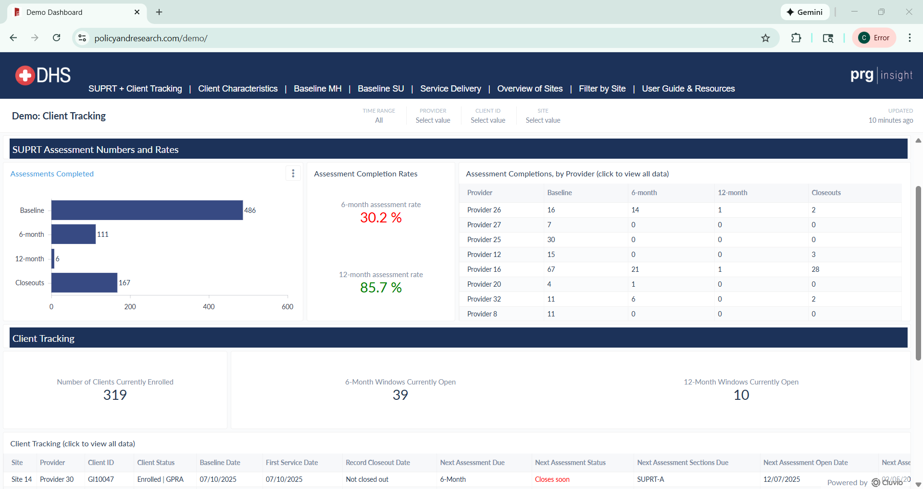
Note:
To support program staff in tracking their clients’ SUPRTs due and completed, we include a ‘Client Tracking’ tab on the PRG Insight data dashboard. We go over how to use this tool in Part 3 of this training.
Client Tracking tab of the PRG Insight data dashboard.

Slide 48
Part 3: SUPRT Materials

Slide 49
Client IDs
SUPRT Online Form
Data Collection Materials
Client Tracking Dashboard
SUPRT Resources

Slide 50
Client IDs
Client IDs
  ID Requirements
  Client IDs should:
  Include letters and/or numbers (up to 9 characters)
  Be securely stored for future use
  Client IDs should NOT:
  Include special characters
  Contain identifying information (e.g., SNN, date of birth)
  Be duplicated or re-used
  Case managers must assign a unique client ID to each client at their baseline assessment.
  “Unique" means that the ID has not been assigned to any prior or current client served by this grant program.
  case managers must use the same ID on all subsequent assessments for that client.
  This ensures identifying client information is never submitted to PRG or SAMHSA.
  Note: Check with your supervisor if you are not sure about your organization’s process for assigning client IDs.

Slide 51
SUPRT Online Form
Client IDs
  Bookmark the SUPRT Online Form link in your browser for easy access each time you need it!
SUPRT Online Form
  PRG will give case managers a link to the SUPRT Online Form.
  Case managers will also have access to SUPRT PDFs that can be printed if needed to accommodate client needs.
How to create bookmarks in Chrome.

Slide 52
Client Tracking Dashboard
Client IDs
  Add another bookmark for the Client Tracking Dashboard!
SUPRT Online Form
Client Tracking Dashboard
  PRG will give case managers a link to access the PRG Insight data dashboard, including a Client Tracking tab – a tool to monitor which clients are due for assessments.
Client Tracking tab of the PRG Insight data dashboard

Slide 53
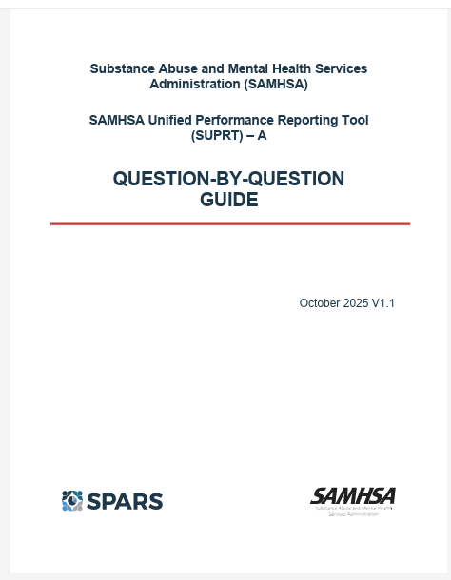
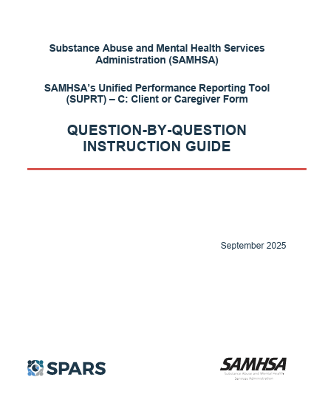
SUPRT Resources
Client IDs
SUPRT Online Form
Client Tracking Dashboard
SUPRT Resources
  User Guide & Resources tab contains guides to help you complete the SUPRT.
  Links to these resources are included in the User Guide & Resources tab of the dashboard.

Slide 54
Part 4: SUPRT Instructions

Slide 55
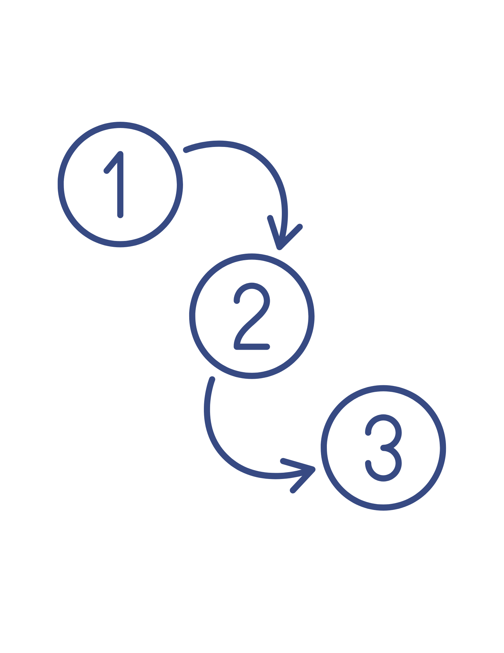
Overview of SUPRT Instructions
Assign or look up client ID number
Open SUPRT Online Form and complete Record Management questions
Obtain client consent for SUPRT-C (if required at timepoint)
Have client complete SUPRT-C
Complete SUPRT-A (using the same online form)
Track assessments due using the Client Tracking Dashboard and email notifications

Slide 56

At baseline…
Assign a unique client ID. Client IDs:
  May contain letters and/or numbers and can include up to 9 characters
  Should NOT contain special characters (like dashes, slashes, hashtags, punctuation) or identifying information (do not use initials, SSN, or date of birth)
  Should be saved and securely stored for future assessments
At reassessment (6-month, annual, record closeout)…
Look up the client’s unique ID in your records
Assign or look up client ID number
Client IDs

Slide 57

Access the SUPRT Online Form using the link provided by PRG
Carefully enter your email address
Select the assessment type
Carefully enter the client ID number
Answer all Record Management questions
If SUPRT-C is required at the time point selected, you will continue to the client consent information section
Open and complete SUPRT Online Form
SUPRT Online Form

Slide 58

Watch this 2-minute video to see how to complete the SUPRT Record Management Section:
  Watch on YouTube for closed captions

Slide 59

Review the consent information (included in the SUPRT Form) with the client…
Obtain client consent
SUPRT Online Form

Slide 60
Consent Guidelines (included in the SUPRT form)
Clients may indicate at any point that they do not wish to complete the assessment.
Participation, although encouraged, is completely voluntary.
Declining does not affect a client’s eligibility for any grant-funded services and does not negatively affect grantee compliance.
Clients can leave any question they do not want to answer blank.

Slide 61
Review the consent information (included in the SUPRT Online Form) with the client
Obtain client consent
Answer the question indicating if the client agrees to complete the SUPRT-C (if no, indicate why; if yes, enter the client assessment date)
SUPRT Online Form

Slide 62

If the client agrees to complete the SUPRT-C, determine how they will complete it based on the following options…
Have client complete SUPRT-C
SUPRT Online Form

Slide 63






Client Options for Completing SUPRT-C
Client completes the SUPRT-C themselves using the case manager’s computer or device
Client completes SUPRT-C interview-style (the case manager reads the questions and response options aloud, filling out the online form as they go)
Client completes paper version of SUPRT, case manager enters data into the online form

Slide 64
2. The client responds to the SUPRT-C questions
Have client complete SUPRT-C
SUPRT Online Form

Slide 65
Completing both SUPRT forms
SUPRT-A and SUPRT-C are completed in the same online form.
Once the client has completed SUPRT-C, the online form continues to the provider (case manager) section (SUPRT-A).

Slide 66

Answer SUPRT-A questions using client records
Click the “submit” button at the end of the online form to complete
Check your inbox for a confirmation email confirming the online form was submitted (email also includes all responses submitted in the form) – if you do not see the email in your inbox, check your spam folder
Complete SUPRT-A
SUPRT Online Form

Slide 67

SUPRT Confirmation Emails
Click to watch this 1 min video about confirmation emails
  Watch on YouTube for closed captions

Slide 68
SUPRT-A Reminders
Must be completed at each assessment timepoint that the client is still in care, even if the client refuses to complete SUPRT-C
Behavioral health data can be entered by any grantee staff (they do not need to be a licensed clinician)
To fill out SUPRT-A, pull information from data recorded in your organization’s record keeping system(s)
If the information is not available in your organization’s record keeping system(s), you should select the response option: Not documented in records or not documented in records using this standard.

Slide 69

SUPRT-C Video Tutorial
The online form makes completing SUPRTs easy! It alerts you of potential errors and uses logic to hide irrelevant questions. Watch the 2-min video:
  Watch on YouTube for closed captions

Slide 70

How to Submit a SUPRT Form
Once you have filled out the SUPRT Online Form, you must click “submit” for responses to be recorded.
SUBMIT
You will receive a confirmation email from PRG to let you know that the form was submitted.
If you do not get a confirmation email, the form was not submitted or received by PRG.

Slide 71
How to Complete SUPRT Offline
The SUPRT can be completed offline but responses still must be submitted online.
If for some reason you do not have internet access, you and the client can complete the SUPRT using a PDF linked on the User Guide & Resources tab of the dashboard (PDF must be printed).
Case managers are responsible for making sure responses from paper/PDF SUPRTs are then entered and submitted in the SUPRT Online Form.

Slide 72

To keep track of when clients are due for reassessment, open the Client Tracking Dashboard using the link provided by PRG.
Go to the Client Tracking tab.
Use the tab filters to view detailed client information for a specific client ID, provider, and/or time range.
Reach out to clients who are still receiving services with open data collection windows to schedule a time to complete SUPRT-C (if applicable).
Track assessments due
Client Tracking Dashboard

Slide 73

Client Tracking Dashboard Video Tutorial
Watch to learn more about using the Client Tracking Dashboard
(1 min):
  Watch on YouTube for closed captions

Slide 74
On the User Guide & Resources tab of the dashboard, you will find:
Links to helpful resources (like this training, SAMHSA’s Question-by-Question Guides, and PDF versions of SUPRT)
Definitions of key terms to contextualize the data presented
Tips for using the interactive features of the dashboard (like how to use filters, expand tables, and hover over elements for additional information).

Slide 75
Reminder About Reassessments
Remember that a reassessment SUPRT is only required for clients still enrolled (receiving grant-funded program services) at the time the window opens.

Slide 76


Automated email reminders
To help you keep client data up to date, PRG sends automated emails:
On the days reassessment windows open, you will receive an email that lists the client ID(s) for the clients you enrolled (clients for whom you completed a baseline form) that are now due for data collection.
On a monthly basis, you will receive an email that lists all the clients you enrolled that are still enrolled (have not had a Record Closeout SUPRT)
These emails prompt case managers to check the Client Tracking Dashboard and complete Record Closeouts, as needed.

Slide 77
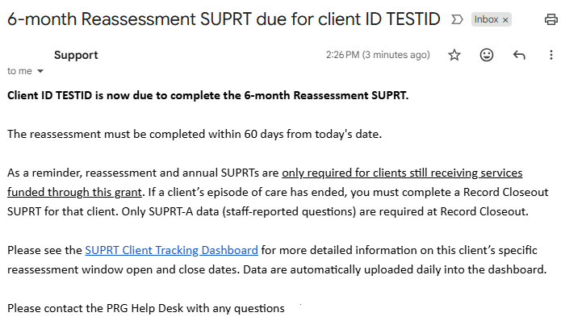
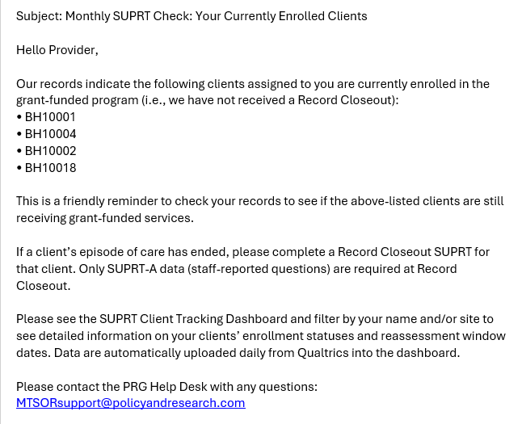
Reminder Email Examples
Reassessment reminder email example:
Monthly reminder email example:

Slide 78
Learning Checkpoint 4:
?
Where should you look if you want to know if a client is due for a reassessment SUPRT?

Slide 79
Answer to Learning Checkpoint 4:
Your email and/or the Client Tracking Dashboard. PRG sends an email when a client’s data collection window opens. You can also check the Client Tracking Dashboard any time to see if and when a SUPRT is due.
A

Slide 80
Frequently Asked Questions

Slide 81
Frequently Asked Questions
Click the question to see the answer; then click the button to return to this slide.
Who is PRG?
What is SUPRT?
When does SUPRT need to be completed?
How do I start completing SUPRTs?
How do I know when a SUPRT is due?
A client refuses to complete the SUPRT-C. Do I still need to complete a SUPRT-A for that client?
Are there expected completion rates for the SUPRT?
What if my client’s reassessment window closed before I was able to complete a SUPRT?
What if my client was enrolled using the GPRA?
Do clients receive incentives for completing SUPRT?
What if a client was discharged and re-enrolls in services?
What if I have a question or an issue related to data collection?

Slide 82
Who is PRG?
The Policy & Research Group (PRG) is a private research and evaluation firm based in New Orleans, Louisiana. Learn more at policyandresearch.com
PRG created PRG Insight, a web-based system for grant-required data collection and reporting based on over 20 years of experience working with SAMHSA grantees. Learn more at prginsight.com

Slide 83
What is SUPRT?
SAMHSA’s Unified Performance Reporting Tool (SUPRT) is a questionnaire that collects data from clients receiving SAMHSA-funded services
It is used to standardize the data that are collected across all of SAMHSA’s grant programs
PRG created a web-based version of the tool (SUPRT Online Form) to help ease the burden of data collection and reporting on case managers
Case managers can access data collected in the SUPRT via the PRG Insight data dashboard.

Slide 84
When does SUPRT need to be completed?
The SUPRT must be completed at the client’s intake into, and discharge from, the grant-funded program.
The SUPRT is required:
  6-months after intake (if still enrolled in services)
  Annually (every 12 months, if still enrolled in services)

Slide 85
How do I start completing SUPRTs?
Access the link to the SUPRT Online Form and enter your email address and the unique ID number for your client. Then, the online form will guide you and your client to the applicable questions based on the assessment type that is due.
Once you (and your client) have completed a SUPRT in the online form, the data in the Client Tracking tab of the data dashboard will update. PRG will upload the data to SPARS.

Slide 86
How do I know when a SUPRT is due?
Case managers will receive reassessment reminder emails for their currently enrolled clients the day their data collection window opens.
Case managers should also access the Client Tracking Dashboard online to monitor when reassessment windows open and close for their enrolled clients. Keep this link bookmarked for easy access throughout the grant!

Slide 87
What if a client refuses to complete the SUPRT-C?
You must still complete a SUPRT-A for that client. Clients can refuse to complete the SUPRT-C, and it does not affect their eligibility to be enrolled in grant-funded services.
In the SUPRT Online Form, you will answer the Record Management questions using data from your organization’s record keeping systems. Once you get to the SUPRT-C: Consent Information section, you will be asked if the client (or their caregiver) agreed to complete the assessment; select “No”, and then select “Client/Caregiver was unable to provide consent” for the reason. The online form will then guide you through the applicable SUPRT-A sections.

Slide 88
Are there expected completion rates for SUPRT?
Previously, SAMHSA required an 80% completion rate for follow-up GPRAs but expectations for the SUPRT are different.
For SUPRT, grantees are expected to complete Baseline and Record Closeout SUPRTs for 100% of clients receiving services under the grant.
SAMHSA has not set required completion rates for 6-month and annual assessments; however, staff should attempt to submit the SUPRT within the 60-day window for 100% of clients still receiving services at that timepoint.

Slide 89
What if my client’s reassessment window closed before I was able to complete a SUPRT?
If you were unable to complete a reassessment during the 60-day window, complete the next assessment due.
For example, if the 6-month window is missed and the client is still in care at 12 months, complete an Annual Assessment when that window opens.

Slide 90
What if my client was enrolled using the GPRA?
If the client is still receiving services, check the Client Tracking Dashboard to see when the client is due for their next assessment (e.g., 6-month, annual).
Clients who completed the GPRA tool at intake do not need to complete the client-reported SUPRT-C sections at any reassessment timepoint. Only staff-reported SUPRT-A data are collected for GPRA clients at reassessment.
When the client is ready to be discharged, complete a Record Closeout in the SUPRT Online Form.

Slide 91
Do clients receive incentives for completing the SUPRT?
Clients who complete the SUPRT-C at 6-month reassessment or annual assessment are eligible to receive 1 gift card or voucher per completed assessment, with a maximum cash value of $30/completed assessment.
Talk to your grant contact or supervisor if you have any questions about your program’s incentive policy.

Slide 92
What if a client was previously discharged and re-enrolls in services?
A new set of SUPRT assessments are required (baseline, record closeout, and reassessment/annual assessment if the client is still in care at those timepoints) for this client’s new episode of care, using the same client ID that was used on the original assessments.
Email the PRG analyst to let us know that the client is re-enrolling in services. PRG will contact you within 2 business days to let you know when you can enter a new baseline SUPRT for this client into the online SUPRT form.

Slide 93
What if I have a question or an issue related to data collection?
If you have a question or want more information on a SUPRT-A or -C question or response option, refer to the SUPRT-A and SUPRT-C question-by-question guides that are saved in the ‘Resources’ section of the User Guide & Resources tab.
If you have a question or issue related to data collection and/or using the PRG Insight dashboard, email the PRG analyst.

